Slide 1
IP Security (IPSec)

Slide 2
IP Security (IPSec)
The Internet Protocol (IP) decides the path for the data that moves between the two networks.
The IP packets move from device to device (Typically routers) before they reach the destination.
In this process the packets cross different unknown networks.
Thus there is always a chance of this data being intercepted and read or changed.
The default design of the IP protocol does not have any built-in mechanisms to avoid this.

Slide 3
IP Security (IPSec)
As more critical applications started using internet and they required a security mechanism to protect IP communication.
The solution developed is IPSec.
Internet Protocol Security (IPSec) is a suite of protocols used to secure the IP communication between the networks.
The protocols in the suite combine together to provide various types of protections.

Slide 4
IPSec provides data privacy by encrypting the data.
It also supports peer-authentication, data origin authentication, data integrity and replay attack protection.
The IPSec works at the Internet Layer (Network layer ) to provide security.
Thus any TCP\IP application working at the higher level can use these security features without requiring any modifications.
This is in contrast to the use of TLS\SSL which is required to be integrated in the application.

Slide 5
Thus IPSec provides an easy security implementation for the applications.
The IPSec is an official standard specified by the Internet Engineering Task Force(IETF).
As IPSec is a suite of various services and protocols they are defined by a series of RFC’s by IETF.
IPSec is an Open Standard.
The IPSec provides two modes to suffice different network needs.
IPSec is optional in IPV4 implementation but is integrated in IPV6.

Slide 6
A Glimpse of IPSec
IPSec can be established by the two end hosts or by the intermediate devices like routers or firewalls.
When these two devices decide to use IPSec communication, they first need to create a secure channel between them which may pass through many insecure intermediate systems.
These devices agree on a same set of security protocols to use for proper secure data transfer between them.
They have to decide on a specific encryption algorithm to use for encrypting the data.
They must exchange the keys that are used to lock or unlock the data.
Normally not the entire traffic that flows between these two devices requires IPSec .
Thus to avoid unnecessary overheads on the devices using IPSec first the traffic which requires security is identified.
When a device encounters such traffic it starts the IPSec procedures.

Slide 7

IPSec can be implemented in two modes – 1. Transport Mode
Transport Mode
In Transport Mode the IPSec communication is between host to host.
In this mode only the data portion of the packet (payload)is encrypted.
In this mode a field containing the IPSec information is added after the IP header in the packet.
Here as the IP header is not changed or encrypted , the packet's are routable.
Any change in the packet will invalidate the packet, thus it can not traverse through a NAT device which changes IP address.

Slide 8
Tunnel Mode.
Tunnel Mode
The Tunnel mode of IPSec is generally preferred in network-to-network , host-to-network or host-to-host communications.
In this mode the entire IP packet (IP header + payload) is encrypted.
As the entire IP packet is encrypted the intermediate devices will not be able to route the packet to the destination .
To solve this problem an additional IP header is attached to the encrypted IP packet.
However the IP address in this header does not point to the actual destination of the packet but to the device at the other end of the IPSec tunnel.
The encrypted IP header contains the actual destination IP address.
The IPSec information field is added after the additional IP header in the new packet.

Slide 9
Security Association
When these two devices decide to use IPSec communication, they first need to create a secure channel between them which requires an agreement on a same set of security protocols to use for proper secure data transfer between them and also on a specific encryption algorithm , key exchange method to use for encrypting the data.
This process is known as forming a security association.
The security associations are unidirectional means they apply for the data moving in one direction only.
SA is a data structure containing keys and other relevant information for the connection.
Thus if two devices A and B decide to use IPSec they have to form two security associations (SA’s).
One SA affects the traffic moving from A to B and the other SA affects the traffic from B to A.
A single device can communicate with any number of devices by using IPSec, thus there will be n number of security associations created.

Slide 10
Again each security association may have a different agreement related to security protocols and methods to be used for the data.
Thus a device is required to use the agreed set of protocols or methods each time it sends or receives data from another device .
Thus to easily identify the security associations with different devices and also the associated algorithms or methods , every device creates a database of the security associations it forms.
This database is known as Security Association database (SAD).
Each SA has a related index in SA database, called SPI (Security Parameter Index).
By using Internet Key Exchange (IKE), two ends negotiate SA and put SA into their SA database.
A sender will put SPI in the IPSec’s SPI field of every IP packet
The receiver will look up its SA database to find the SA corresponding to the SPI in the IP packet.
Separate SA’s are used between the two devices for different kinds of IPSec connections .

Slide 11
However as mentioned earlier not all the traffic between the two devices require IPSec to be used.
Using IPSec for the entire communication will increase overhead on the devices.
Thus a security policy is crated to identify the traffic which can be treated as an interesting traffic for the IPSec.
The security policy is a rule created in the IPSec.
The traffic which is not identified by the security policy goes on the network as it is.
The policies are stored in a Security Policy database.
The security policy not only identifies the interesting traffic but also tales whether it requires encryption and or integrity also.
The security policy also holds the information about the integrity or encryption algorithms to be used.
The decision for the interesting IPSec traffic can be based on any field in the IP packet.
Generally the source IP address, destination IP address, protocol and layer 4 protocol ports are used.

Slide 12
IPSec uses two protocols to provide security.
Authentication Header (AH) and Encapsulation Security payload (ESP).
The Authentication header provides two services- Authentication and Integrity.
Authentication here relates to making sure that the data received has come from the same source mentioned in the received packet.
The Integrity service makes sure that the data has not been altered between the source and the destination.
The Authentication service is provided by the AH by computing a cryptographic Hash-based Message Authentication Code (HMAC) over the IP packet.
However some fields of the IP header change in transit from source to destination. These fields are called mutable fields.
During HMAC calculation the mutable field actual values are not used rather the value is replaced by 0.
Some of the mutable fields of the IP packet are TTL(Time-To-Live), TOS(Type of Service), Flags, fragment Offset , Header Checksum etc.

Slide 13
This value is known as Integrity Check Value (ICV).
The ICV value calculation involves IP header immutable fields, AH header fields, and higher layer protocol data.
This value is added in a new AH header which is added in the IP packet and sent to the other end.
The IPSec AH header format is as shown below.
0 1 2 3
0 1 2 3 4 5 6 7 8 9 0 1 2 3 4 5 6 7 8 9 0 1 2 3 4 5 6 7 8 9 0 1
+-+-+-+-+-+-+-+-+-+-+-+-+-+-+-+-+-+-+-+-+-+-+-+-+-+-+-+-+-+-+-+-+
| Next Header | Payload Len | RESERVED |
+-+-+-+-+-+-+-+-+-+-+-+-+-+-+-+-+-+-+-+-+-+-+-+-+-+-+-+-+-+-+-+-+
| Security Parameters Index (SPI) |
+-+-+-+-+-+-+-+-+-+-+-+-+-+-+-+-+-+-+-+-+-+-+-+-+-+-+-+-+-+-+-+-+
| Sequence Number Field |
+-+-+-+-+-+-+-+-+-+-+-+-+-+-+-+-+-+-+-+-+-+-+-+-+-+-+-+-+-+-+-+-+
| |
+ Authentication Data (variable) |
| |
+-+-+-+-+-+-+-+-+-+-+-+-+-+-+-+-+-+-+-+-+-+-+-+-+-+-+-+-+-+-+-+-+
This header is placed between the original IP header and the payload.

Slide 14
As shown in the earlier diagram the AH header contains five important fields.
AH header fields.
Next Header
This field is of 8 bits.
This field identifies the protocol whose payload follows the AH header.
This field contains a number which represents a protocol from the set of IP protocols.
These numbers are defined by the Internet Assigned Numbers Authority (IANA).
The list is also available at the following link.
http://en.wikipedia.org/wiki/List_of_IP_protocol_numbers
Payload Length
This is an 8-bit field.
This specifies the length of the AH .
The length of the AH is specified in 32 bit words (4-byte units) minus 2.

Slide 15
Reserved
This field is of 16 bits.
This field is reserved for future use.
This field is set to all zeros.
Security Parameter Index(SPI)
The SPI is an arbitrary 32 bit value.
This value along with the destination IP address and AH protocol uniquely identifies the security association for this datagram.
As a system can have multiple security associations, thus this value points to the session keys and algorithm to be used for the datagram.
Sequence Number
This 32 bit unsigned field is a counter.
When a security association is established between the two devices this counter at both the ends is set to 0.
As the packets are transmitted this counter is increased each time.
This field provides protection against the replay attack.

Slide 16
This field is compulsory for the sender means the sender needs to increase the counter each time it sends the packet.
The receiver is to decide whether it will use this field as anti-replay solution.
If the receiver decides to use this field as replay protection then the sequence numbers will never be allowed to cycle.
Any packet having the earlier sequence number will not be accepted by the receiver.
Thus after every 2^32 packet on a security association the counter at both the sides is required to be reset.
Also the counter is reset whenever a new association is created.
Authentication Data
This is a variable length field.
This field contains the Integrity Check value (ICV) i.e. the hash value of the packet .
This field must be an multiple of 32 bit word.
Thus the ICV value may be padded to fulfill the requirement.
The entire Ah header length must be either multiple of 32 bits (IPV4) or 64 bits (IPV6).

Slide 17
Normal IP Packet
Transport Mode AH IPSec Packet
Tunnel Mode AH IPSec Packet
IP Header
Data
IP Header
AH Header
Data
New IP Header
AH Header
IP Header
Data

Slide 18
The second IPSec protocol – Encapsulating Security Payload (ESP) provides encryption and / or integrity for an IP packet.
Thus if the need is the data privacy (confidentiality) then ESP is the only solution.
However for data integrity needs either AH or ESP can be used.
Both AH and ESP can be used together to provide both confidentiality and integrity.
The previous AH documentation shows that AH adds IPSec information in the header only.
However ESP adds a header and a trailer to the original IP packet.
But still it is known as ESP header.
The protocol number of ESP is 50.
ESP always performs encryption of the IP packet, but it can be avoided by using special “null encryption “ algorithm.
The “null encryption” algorithm is specified in RFC 2410.
However with ESP the firewalls or intermediate routers can not read the upper layer information like TCP or UDP source or destination ports.

Slide 19
The ESP header format is as shown below.
0 1 2 3
0 1 2 3 4 5 6 7 8 9 0 1 2 3 4 5 6 7 8 9 0 1 2 3 4 5 6 7 8 9 0 1
+-+-+-+-+-+-+-+-+-+-+-+-+-+-+-+-+-+-+-+-+-+-+-+-+-+-+-+-+-+-+-+-+ ----
| Security Parameters Index (SPI) | ^Auth.
+-+-+-+-+-+-+-+-+-+-+-+-+-+-+-+-+-+-+-+-+-+-+-+-+-+-+-+-+-+-+-+-+ |Cov-
| Sequence Number | |erage
+-+-+-+-+-+-+-+-+-+-+-+-+-+-+-+-+-+-+-+-+-+-+-+-+-+-+-+-+-+-+-+-+ | ----
| Payload Data (variable) | | ^
~ ~ | |
| | |Conf.
+ +-+-+-+-+-+-+-+-+-+-+-+-+-+-+-+-+-+-+-+-+-+-+-+-+ |Cov-
| | Padding (0-255 bytes) | |erage*
+-+-+-+-+-+-+-+-+ +-+-+-+-+-+-+-+-+-+-+-+-+-+-+-+-+ | |
| | Pad Length | Next Header | v v
+-+-+-+-+-+-+-+-+-+-+-+-+-+-+-+-+-+-+-+-+-+-+-+-+-+-+-+-+-+-+-+-+ ------
| Authentication Data (variable) |
~ ~
| |
+-+-+-+-+-+-+-+-+-+-+-+-+-+-+-+-+-+-+-+-+-+-+-+-+-+-+-+-+-+-+-+-+
Some fields of the ESP header are optional . The selection of the fields entirely depends upon the security features of the ESP used.
These optional fields are not transmitted and their values are not considered while calculating hash values.

Slide 20
As shown in the earlier diagram the ESP header contains seven important fields.
ESP header fields.
Security Parameter Index(SPI)
The SPI is an arbitrary 32 bit value.
This value along with the destination IP address and ESP protocol uniquely identifies the security association for this datagram.
As a system can have multiple security associations, thus this value points to the session keys and algorithm to be used for the datagram.
It is a mandatory field.
Sequence Number
This 32 bit unsigned field is a counter.
When a security association is established between the two devices this counter at both the ends is set to 0.
As the packets are transmitted this counter is increased each time.
This field provides protection against the replay attack.
It is the receiver who decides whether to use this field or not.

Slide 21
This field is compulsory for the sender means the sender needs to increase the counter each time it sends the packet.
The receiver is to decide whether it will use this field as anti-replay solution.
If the receiver decides to use this field as replay protection then the sequence numbers will never be allowed to cycle.
Any packet having the earlier sequence number will not be accepted by the receiver.
Thus after every 2^32 packet on a security association the counter at both the sides is required to be reset.
Also the counter is reset whenever a new association is created.
Payload Data
The length of this field is variable.
It contains the data as described by the next header field.
Some encryption algorithms require a cryptographic synchronization data called initialization vector (IV).
In these cases this field contains IV value.

Slide 22
Depending upon the algorithm selected during security association the IV length may vary.
It can be zero also for some algorithms.
This field also contains the protected data in encrypted format.
Thus if ESP is implemented in tunnel mode then the beginning of the data would be an IP header.
However if the ESP is implemented in transport mode then the beginning of the data would be an upper layer protocol header like TCP, UDP etc.
This field is mandatory.
Padding
The data padding is used for various reasons.
Most of the encryption algorithms used are block ciphers so that they work on a predefined sized block of data.
Thus in case if data is short in length it may be padded to fulfill the above requirement.
Also some algorithms may use data padding so that the resulting cipher text length is different than the actual plain text.

Slide 23
It is also used to align some of the ESP header fields to a 4 byte boundary.
Pad Length
This field indicates the number of pad bits used in bytes.
The value can be from 0-255.
The value of zero indicates that no padding is used.
This field is mandatory.
Next Header
This field is of 8 bits.
This field identifies the protocol whose payload follows the ESP header.
This field contains a number which represents a protocol from the set of IP protocols.
These numbers are defined by the Internet Assigned Numbers Authority (IANA).
The list is also available at the following link.
http://en.wikipedia.org/wiki/List_of_IP_protocol_numbers

Slide 24
Authentication Data
This is a variable length field.
This field contains the Integrity Check value (ICV) i.e. the hash value of the packet .
This field must be an multiple of 32 bit word.
Thus the ICV value may be padded to fulfill the requirement.
The entire ESP header length must be either multiple of 32 bits (IPV4) or 64 bits (IPV6).
However if ESP is used only for encryption then this field is of zero length.
While calculating the ICV value all fields in the ESP ( SPI to Next Header) except this field are included.
Thus in ESP if encryption is used the following fields are encrypted.
DATA, PADDING, PAD LENGTH and NEXT HEADER.
If integrity protection is used then only the AUTHENTICATION DATA field is inserted in the ESP header.

Slide 25
Normal IP Packet
Transport Mode ESP IPSec Packet
Tunnel Mode ESP IPSec Packet
IP Header
Data
IP Header
ESP Header
Data
ESP trailer
ESP Auth
New IP Header
ESP Header
IP Header
Data
ESP Trailer
ESP Auth

Slide 26
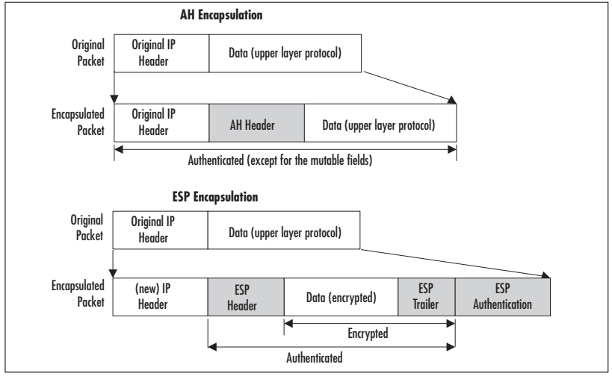

Slide 27
IPSec Internet Key Exchange (IKE)

Slide 28
IPSec uses the concept of the “shared secret” to communicate.
This makes sure that two devices who know this shared secret can exchange data securely.
However for this the two devices are required to communicate this shared secret to each other.
This is achieved by using Internet Key Exchange (IKE) protocol which is a general purpose key exchange protocol .
It is used by IPSec, but it can be used by other protocols who need SAs as well.
IKE protocol is based on Oakley, SKEME and Internet Security Association and Key management Protocol(ISAKMP).
ISAMKP (Internet Security Association and Key Management Protocol):
Provides a framework for authentication and key exchange, (not a protocol, suppose support different key exchange)
OAKLEY
Describe a series of key exchanges and services (e.g. perfect forward secrecy, identity protection, and authentication)

Slide 29
SKEME (Secure Key Exchange MEchanism)
describes a versatile key exchange technique which provides anonymity, repudiability, and quick key refreshment.
IKE is a key exchange mode of the ISAKMP.
Internet Key Exchange(IKE) creates Security Associations (SA). That is, parties in IKE negotiate keys for the SA.
IKE protocol is defined by RFC 2409.
It is one of the more complicated protocol of the IPSec protocols.
In this process the IPSec systems first authenticate themselves to each other and establish ISAKMP (IKE) shared keys.
IKE uses the UDP port 500 (normally) .
IKE is a request-response type of protocol.

Slide 30
There are two phases involved in the IKE process.
In phase 1 of this process, IKE creates an authenticated, secure channel between the two IKE nodes, known as the IKE security association.
The Diffie-Hellman key agreement is always performed in this phase.
In phase 2, IKE negotiates the IPSec security associations and generates the required keys for IPSec.
A new Diffie-Hellman agreement may be done in phase 2, or the keys may be derived from the phase 1 shared secret.
In the first phase of the IKE exchange, an authentication method is agreed.
There are four authentication methods
1) pre shared secret key
2) public key signature
3) public key encryption
4) Revised public key encryption.

Slide 31
There are two modes of IKE phase 1- Aggressive Mode and Main Mode.
In aggressive mode the peer authentication and the session key establishment task is accomplished in three messages only.
For the same task the main mode takes six messages.
The main mode additionally provides protection from eavesdropper by hiding the endpoint identifiers.
It also provides a flexibility in negotiating cryptographic algorithms.
The flow of the six messages of the main mode of the IKE are shown in the following slide.
The device which starts the security association process is called initiator and the other end device is called the responder.
In the first message the initiator sends a cookie and the preferred order of the cryptographic algorithms supported .
A cookie is the result of hashing a unique identifier of the peer (peer’s IP address, port and protocol), a secret known only to the generator of the cookie, and a time stamp.
The initiator generates a cookie, sets the responder cookie to zero and sends to the responder.

Slide 32
IKE phase 1—main mode
Crypto suites I support
Crypto suite I choose
gª mod p
Initiator
Responder
g^{b} mod p
g^{ab} mod p{“initiator”, proof I am initiator}
g^{ab} mod p{“responder”, proof I am responder}

Slide 33
In the second message the responder generates a responder cookie, copies the initiator cookie to the message and sends it to the initiator.
In the second message the responder also sends an accepted order of the cryptographic algorithms .
The initiator can easily check that the initiator cookie is to one it generated and that the peer’s addresses match.
Only if the cookie matches, check of signatures etc. are made.
The third and the fourth message uses a Diffie-Hellman exchange to generate shared secret keying material used to generate shared secret keys and to pass nonce—random numbers sent to the other party and then signed and returned to prove their identity.
In fifth and the sixth message each side revel its identity and proves it knows the relevant secret.
The task of main mode is matching IKE SAs between nodes to provide a protected channel for subsequent protected ISAKMP exchanges between the IKE peers.
The IKE SA specifies values for the IKE exchange: the authentication method used, the encryption and hash algorithms, the Diffie-Hellman group used, the lifetime of the IKE SA in seconds or kilobytes, and the shared secret key values for the encryption algorithms.

Slide 34
IKE phase 1—aggressive mode
gª mod p, “Alice”, Crypto proposal
g^{b} mod p, crypto choice, proof I am Bob
responder
initiator
Proof I am Alice
In aggressive mode, only three messages are send between the nodes.
The initiator, in the first message puts almost everything needed to create a SA : the Diffie-Hellman public key; a nonce that the other party signs; and an identity packet, which can be used to verify identity via a third party.
The responder sends everything back that is needed to complete the exchange.
The initiator then confirms the exchange.

Slide 35
The weakness of using the aggressive mode is that both sides have exchanged information before there's a secure channel.
Therefore, it's possible to "sniff" the wire and discover who formed the new SA.
However, it is faster than main mode.
There are eight ways in which the phase 1 process of IKE can take place.
Public Signature Keys, Main Mode
Public Signature Keys, Aggressive Mode
Public Encryption Key, Main Mode, Original
Public Encryption Key, Aggressive Mode, Original
Public Encryption Key, Main Mode, revised
Public Encryption Key, Aggressive Mode, revised
Shared Secret Key, Main Mode
Shared Secret Key, Aggressive Mode

Slide 36
Phase two: quick mode
Phase two of IKE creates IPsec SA.
Since IKE can be used for other protocols than IPsec, like the routing protocols RIPv2 and OSPF, IKE SA is not directly IPsec SA.
The quick mode exchange establishes an ESP and / or AH SA.
IKE SA protects the quick mode by encrypting messages and authenticating them.
The quick mode creates keys for IPSec association.
The initiator for the quick mode can be any node.
It is not necessary that the initiator of the first phase will be the initiator of the second phase.
Many quick modes can be made using the same IKE SA, therefore a message ID (M-ID) is used to identify the IPSec SA. Nonce are added to prevent replay of the same messages by an attacker.

Slide 37
IPSec Algorithms and Methods

Slide 38
Various Types of algorithms are used by IPSec to provide various services.
Following algorithms or methods are used by IPSec.
Integrity Algorithms
Encryption Algorithms
Key Exchange Algorithms
Authentication Methods

Slide 39
Integrity Algorithms
Integrity Algorithms make sure that the data in the packet received from a remote computer was not modified in transit.
The computer sending the data before transmitting it calculates a hash from the data payload part of the packet.
This hash value is then digitally signed and attached to the packet.
The packet is then transmitted.
The receiving computer calculates the hash value from the data payload of the received packet using same algorithm.
This hash value is then matched with the hash value send by the sender computer.
If both the hash values match it means the data is unaltered and the receiving computer accepts the packet.
However if the hash values are different then that means the data is altered in transit and the receiving computer simply drops the packet.
The Integrity algorithms never encrypt the actual data but provide a method for checking data modification in transit.

Slide 40
Message Digest 5 (MD5):
Defined by RFC 1321.
This algorithm takes an input of arbitrary length and produces an 128 bit length output called the message digest.
The MD5 algorithm is intended for digital signature applications.
It is very simple to implement.
However not considered as secure.
It can be used on computers running windows 2000 and above.
Secure Hash Algorithm (SHA):
Federal Information Processing Standards Publication documented the Secure Hash Algorithm as standard.
This document specifies four SHA algorithms.
SHA-1, SHA-256, SHA-384 and SHA-512.
The SHA-1 algorithm produces a 160 bit hash value from an input message of any length.
The SHA-256 and SHA-384 produce a 256 bit and 384 bit hash value respectively.

Slide 41
Higher hash value provides more security however these algorithms tend to increase load on the system.
SHA-3 Family algorithms are under development.
SHA-1 algorithms can work on computers with windows 2000 onwards.
The SHA-256 and SHA-384 algorithms are available on computers with Windows Vista SP1 and Windows 2008.
Advanced Encryption Standard(AES):
Federal Information Processing Standards Publication documented this standard.
Supports two modes of working, Galois Message Authentication Code mode(AES-GMAC) and Galois/Counter Mode (AES-GCM).
It supports a key length of 128 , 192 and 256 bits.
The AES-GCM can encrypt and decrypt the data so it can work as an encrypting algorithm also.
Both the above algorithms are available on computers with Windows Vista SP1 and Windows 2008.

Slide 42
Encrypting Algorithms
These algorithms encrypt the data before transmitting it.
Because of this the confidentiality of the data is maintained during transit.
However encrypting entire traffic can increase load on the system so just encrypt only the required traffic.
Data Encryption Standard(DES):
DES uses 56 bit key for encrypting the data.
It is a block cipher algorithm as it encrypts64 bit of data block.
It is not considered as secure.
It works on computers having windows 2000 and onwards.
3DES:
Provides stronger encryption than DES.
It is also a block cipher.
It uses a three step encryption process.

Slide 43
Advanced Encryption Standard(AES):
Cipher Block Chaining mode (AES-CBC) of AES supports data encryption.
It can encrypt an 128 bit block of data.
It supports keys of length 128 , 192 and 256 bits.
It hides the pattern of the identical blocks of data within a packet.
It is available on computers running windows vista with SP1.
Key Exchange Algorithms
The key exchange algorithms provide a secure way to exchange a shared secret value between two computers.
Most of the time the actual shared secret value is not directly send.
The computers exchange certain information from which they compute the shared secret value.
Thus any computer listening to this communication can not determine the shared secret.
The shared secret can directly work as a key or help in generating a key to encrypt data.

Slide 44
Diffie-Hellman:
Provides a method for two computers to decide on a shared secret value.
This algorithm requires that both the sender and the receiver have a public-private key pair.
The shared secret value is calculated by combining the private key of one computer with the public key of the second computer.
Based on key lengths it is divided into three groups.
DH Group 1, 2 and 14 are the three groups.
DH Group1 provides a 768 bit of key length.
DH Group2 provides a 1024 bit of key length.
DH Group14 provides a 2048 bit of key length.
DH Group 1 is not considered as secure.
DH Group1 and 2 are available on computers running windows 2000 and onwards.
DH Group14 is available on computers running windows XP and onwards.

Slide 45
Elliptic Curve Diffie-Hellman (ECDH):
ECDH provide advanced key exchange values with stronger key strength than DH Groups 1, 2 and 14.
Two algorithms are available ECDH P-256 and ECDH P-384.
Both these algorithms are available on computers with windows vista SP1 and windows 2008.
Authentication Methods
The Authentication methods make sure that any user or computer credentials are securely transmitted to a remote computer.
Pre shared Key:
It is a method in which a text phrase that is configured on the remote systems and used for encrypting the data.
It not considered as a secure method.
It is available on computers running windows 2000 and above.

Slide 46
Kerberos V5:
Kerberos V5 is an authentication protocol used in active directory.
It uses encrypted tickets to transmit credentials.
It works well for users or computers of the same domain or trusted domains.
NTLM V2:
It is Microsoft's challenge/response based authentication protocol.
It can work for users or computers of the same domain or trusted domains.
It also works with active directory.
It is available on computers running windows vista and 2008.
Certificate:
IPSec supports X.509 based certificate for authentication.
The certificate should be issued by a trusted certification authority (CA).

Slide 47
Configuring IPSec in Windows

Slide 48
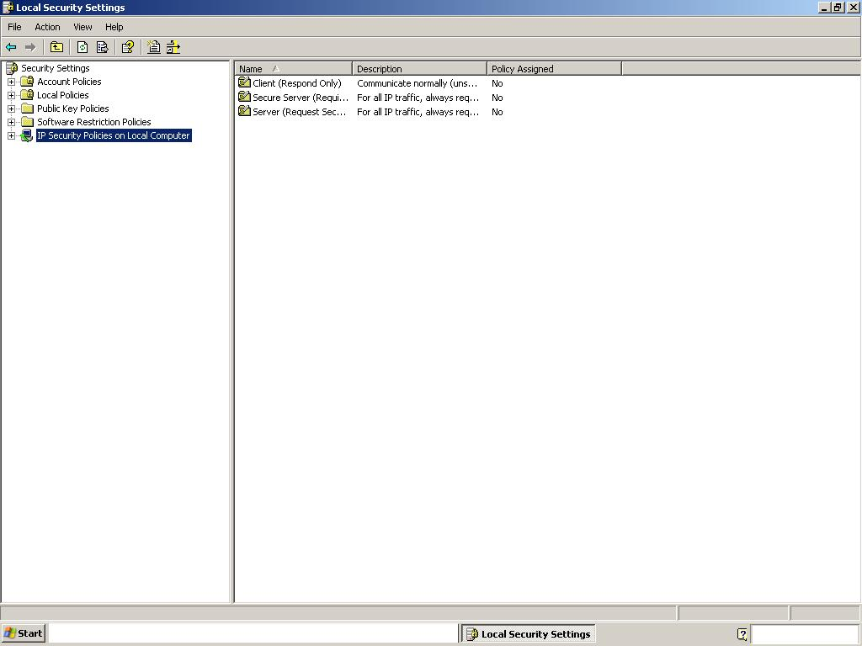
To configure IPSec on a Windows XP computer ……
Click – start – Run-
In the RUN window type secpol.msc
The following window opens showing IP security policy on Local Computer.

Slide 49
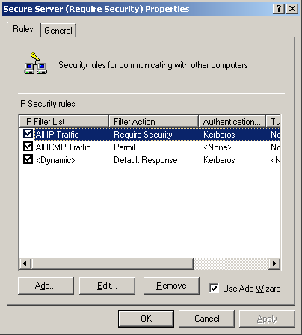
Select IP security policy on Local Computer in the left pane of the MMC.
Right click in the right pane of the MMC window and click create IP security policy.
A policy creation wizard starts , click next , In the window specify a unique name for this policy. Description about this policy can also be added. Click next
In the next window clear check box
for activate the default response
rule. Click next .
In the next window keep
the check box for edit
properties selected.
Click next.
A window as shown will open.
Just clear the check box for
Use Add Wizard always.

Slide 50
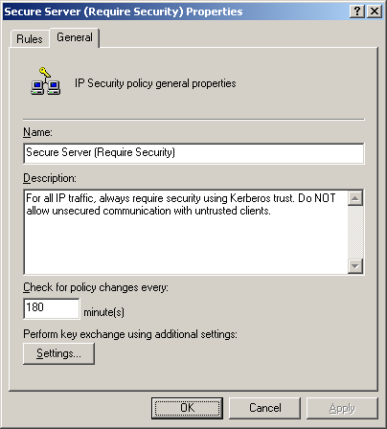
In the earlier window click on the general tab.
The window shown on the right side
opens.
Click the settings button.
A key exchange settings window
opens.
Click on the methods button.
Now a key exchange security
methods window opens , here we
can select the security methods to be
used and their preferred order.
By using add button a new security
method can be added. Remove button can remove a security method. Edit button allows you to modify a selected method.
Move up and Move down buttons are available to set the preferred order.
The following slide shows the figures for these options.

Slide 51
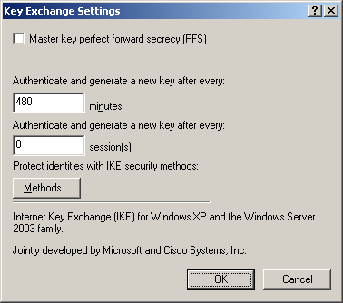
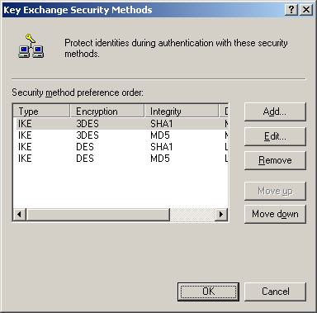
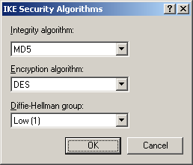
Setting the IKE method and parameters.
In the key exchange settings you can specify the new key generation parameters.

Slide 52
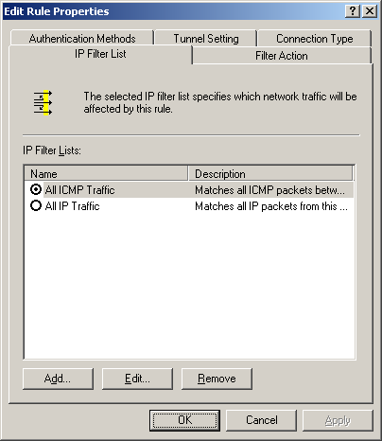
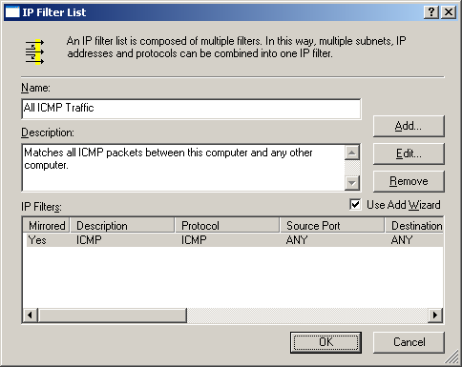
In the IP security policy properties window click on the rules tab.
Uncheck the Use Add Wizard check box.
In that window click on the add button.
The following window opens. Click Add.
This filter list will identify the interesting traffic for IPSec.

Slide 53
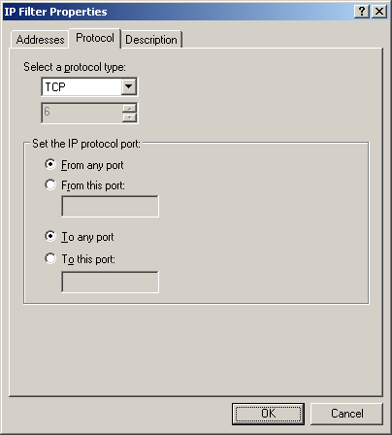
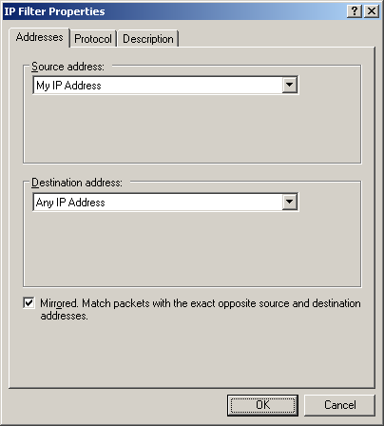
The interesting traffic can be based on a source IP address, Destination IP address, Protocol, Source port, Destination port etc.

Slide 54
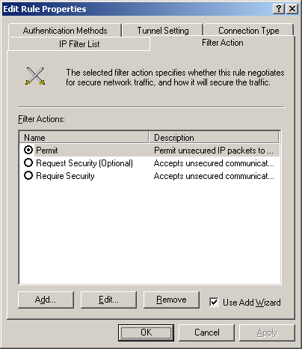
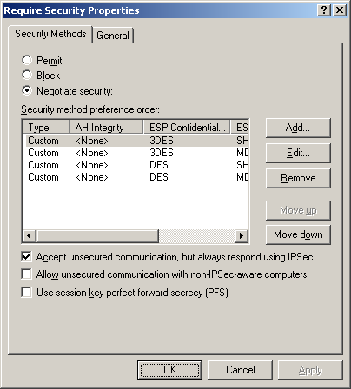
A filter list created earlier will identify some traffic.
Based on the requirement either this traffic will be permitted unsecured or it may be blocked or it can be sent using IPSec.
In the windows shown click on the Add button to add a particular filter action.

Slide 55
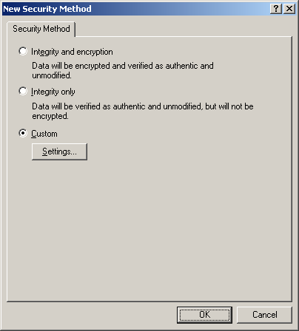
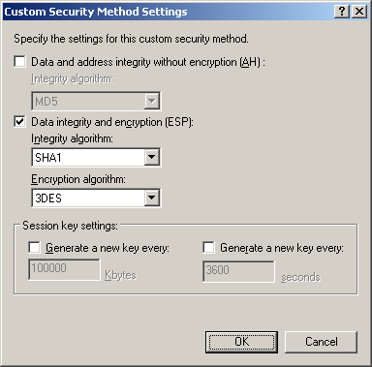
Click Add in the security methods tab of the require security properties window.
This opens a new security method window.
Click custom and click settings button.
This opens custom security methods settings window.
Here you can choose whether you want to use AH or ESP or both.

Slide 56
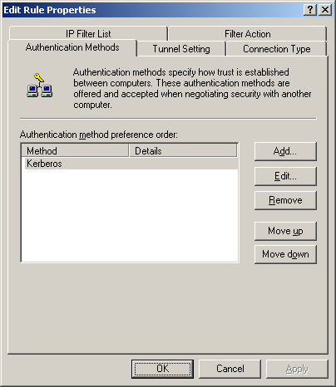
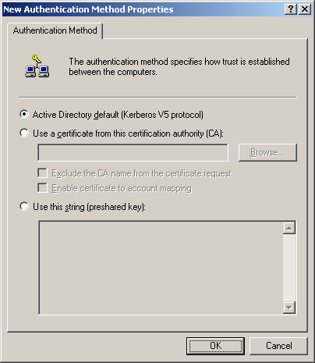
The authentication method can be selected from the authentication tab.
It supports three authentication methods – Active directory (Using Kerberos, using certificates or using pre shared key.

Slide 57
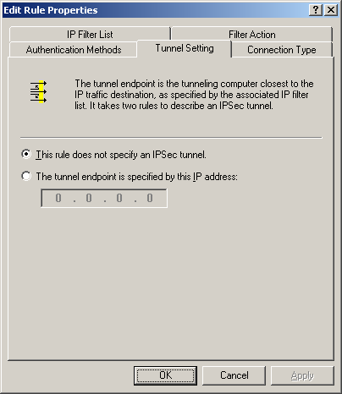
The tunnel endpoint tab allows you to specify the IP address of the end peer which will negotiate the SA.
This setting is required if the IPSec is implemented in tunnel mode.

Slide 58
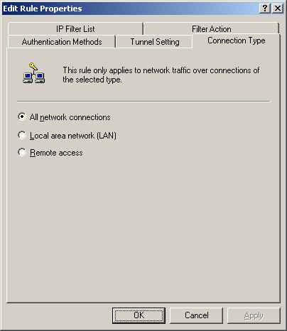
Lastly the connection tab allows you to specify which traffic is considered by the rule.
The rule can apply to either all the traffic or only to the LAN traffic etc.

Slide 59
The IPSec SA’s are unidirectional, thus every IPSec connection requires two SA’s.
While creating a rule a rule for the reverse traffic can also be created by selecting the check box in the following window.
The other end node should be configured the same way.

Slide 60
IPSec Monitoring and Troubleshooting

Slide 61
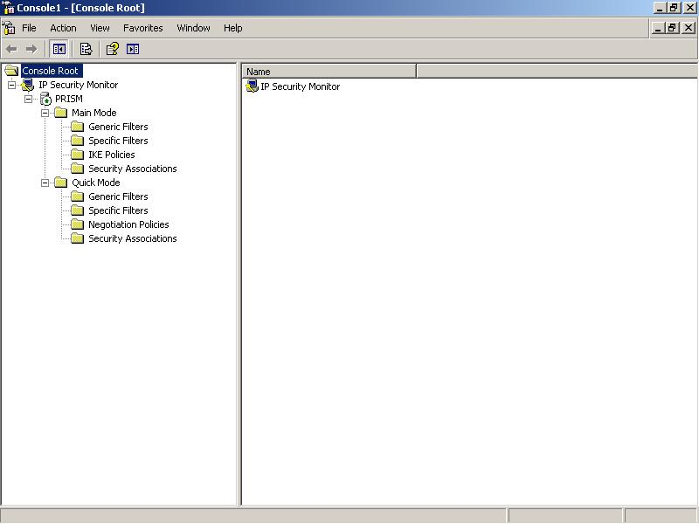
IPSec Monitor
Click Start, click Run, type MMC, and then click OK.
In the MMC, click File, click Add/Remove Snap-in, and then click Add.
Click IP Security Monitor, and then click Add.
Click Close, and then click OK.
By default it monitors the local computer IPSec policies but you can add another computer in the monitor MMC (Windows 2003 server).

Slide 62
The netdiag /test:ipsec command displays the Group Policy object that contains the IPSec policy assignment, and the organizational unit to which the Group Policy object is assigned.
netsh ipsec dynamic show all command on windows 2003 server displays information about all active IPSec policies and statistics.
ipseccmd show all command on windows XP displays information about all active IPSec policies and statistics.
To get all IKE negotiation events in the event viewer , success and failure audit events for Audit Logon Events audit policy should be set.
These events are logged in the security log of the event viewer.
Following registry modification will enable IPSec driver logging of dropped inbound and outbound packets.
Set HKEY_LOCAL_MACHINE\System\CurrentControlSet\Services\IPSec\EnableDiagnostics DWORD registry setting to a value of 7. or
use command netsh ipsec dynamic set config ipsecdiagnostics 7

Slide 63
The value of 7 in the previous command logs all types of IPSec packets.
The other values and type of packet logging is as given below.
Value 1 – it logs bad SPI packets (the total number of packets for which the Security Parameters Index or SPI was incorrect), IKE negotiation failures, IPSec processing failures, packets received with invalid packet syntax, Unauthenticated hashes and other errors are recorded in the System log.
Value 2 – it logs inbound per-packet drop events.
Value3 - all above logs and unexpected clear text events (packets that are sent or received in plaintext) are also recorded.
Value 4 - it logs outbound per-packet drop events.
Value 5 – it logs the events in the 1st value and outbound per packet events.
Value 6 – It logs inbound and outbound per-packet drop events.

Slide 64
Enabling and disabling the IKE tracing log in the Windows Server 2003 family
In the Windows Server 2003 family, you can enable or disable the IKE tracing log dynamically while the IPSec service is running by doing the following:
To enable the IKE tracing log, type the following at the command prompt:
netsh ipsec dynamic set config ikelogging 1
This command creates the IKE tracing log file if it does not exist. If the file does exist, it appends logging information to the existing file.
To disable the IKE tracing log, type the following at the command prompt: netsh ipsec dynamic set config ikelogging 0

Slide 65
Enabling the IKE tracing log in Windows 2000 and Windows XP
In Windows 2000 and Windows XP, you must enable IKE tracing by modifying the registry.
For the changes to take effect, you must also stop and restart the IPSec service:
To enable the IKE tracing log in Windows XP and Windows 2000, do the following:
HKEY_LOCAL_MACHINE\System\CurrentControlSet\Services\PolicyAgent\Oakley
\EnableLoggingDWORD registry setting to a value of 1.
The Oakley key does not exist by default and must be created.
net stop policyagent – stops the IPSec service
net start policyagent - starts the IPSec service
Keep IPSec service updated by downloading patches from Microsoft Web Site.

Slide 66
SSL VPN
SSL VPN allows you to secure your internal resources behind a single entry point device; the remote users only require a Web browser capable of SSL encryption.
The user connects to the SSL-VPN gateway and begins his or her secure session.At this point, the user can access many different types of resources.

Slide 67
SSL VPN
This provides secure ubiquitous client access and because you don’t have to deploy a client, you can easily deploy access to thousands of users in a matter of hours.
A secure tunnel between computers provides secure communication channel between two computers.

Slide 68
SSL VPN
SSL uses asymmetric cryptography to share secrets between the local computers and then uses symmetric keys to encrypt the communication between the SSL gateways.
To rehash, an encrypted tunnel between two computers over an insecure network such as the Internet is known as a virtual private network.

Slide 69
SSL VPN
SSL-VPN thus creates a secure tunnel by making sure both the users are authenticated before allowing access, and encrypting all data transmitted to and from the users by using SSL.
The difference between the IPSecbased VPN and the SSL-based VPN is that IPSec operates at the IP layer or at network layers, and SSL-VPN establishes connection using SSL, which works at the transport and session layers.

Slide 70
SSL VPN
SSL between client and server can in turn be divided into two phases: handshake and data exchange.
The handshake phase between the local machine and the server requires three phases.
First Phase
During the first phase, client and server exchange hello, which in turn enables the client and server to exchange information about the encryption ciphers and the compression algorithms.

Slide 71
SSL VPN
Based on the cryptography and compression algorithms, the client and server decide to cancel or proceed with the session.
Second Phase
The second phase involves the authentication, between client and server, and is done by exchanging digital certificates.

Slide 72
SSL VPN
A digital certificate is issued and signed by the private key of the CA and comprises the following:
Owners public key
Owner’s name
Expiration date of the public key
Name of the issuer (the CA that issued the digital certificate)
Serial number of the digital certificate
Digital signature of the issuer

Slide 73
SSL VPN
Third Phase
In the third phase, client and server wrap up the communication. Closing communication is performed by sending a 1-byte value that conveys finished notification.

Slide 74
Layer 2 VPN Protocols
A Layer 2 solution from Microsoft and Cisco makes use of both the Point-to-Point Protocol and Cisco Layer 2 protocols.
Since the Layer 2 VPN solution provides a significant amount of revenue for the independent local exchange carriers (ILECs) and PTT (Post,Telephone, and Telegraph) service providers, the need for Layer 2 VPN has been increasing.

Slide 75
Layer 2 VPN Protocols
However, the connections for a Layer 2 solution are costly, and the customers want more effective cost solutions.
L2TP
L2TP is a combination of PPTP and Layer 2 Forwarding (L2F), put forth by Cisco Systems. L2TP can encapsulate PPP frames just as PPTP can, but in contrast can then be sent over IP,ATM, or frame relay.

Slide 76
Layer 2 VPN Protocols
It is rather more complicated than PPTP, and more secure.
The IPSec Encapsulating Security Payload (ESP) protocol is used to encrypt L2TP traffic.
As to security, L2TP is extremely strong. In addition to requiring user authentication through PPP, L2TP requires machine authentication via certificates.

Slide 77
Layer 2 VPN Protocols
PPTP versus L2TP
When choosing which layering protocol to use for a secure VPN, you should understand some of the differences between them. One of the largest differences between PPTP and L2TP is the method of encryption each uses. PPTP uses MPPE, and L2TP uses IPSec ESP.

Slide 78
Layer 2 VPN Protocols
When PPTP negotiations happen between a client and the VPN server, the authentication phase is not encrypted, even when using the strongest form of MPPE(128-bit RSA RC4).
IPSec encryption, however, is negotiated even before the L2TP connection is established.This allows the securing of both data and passwords.

Slide 79
Layer 2 VPN Protocols
Even though the implementation of L2TP is more administrative work than PPTP, it is recommended for all high-security environments.
However, keep in mind that both L2TP and PPTP can be used on the same VPN server.
It is also recommended that you use packet filtering and firewalls on all LAN-to-LAN and remote access VPNs.

